Slide 1
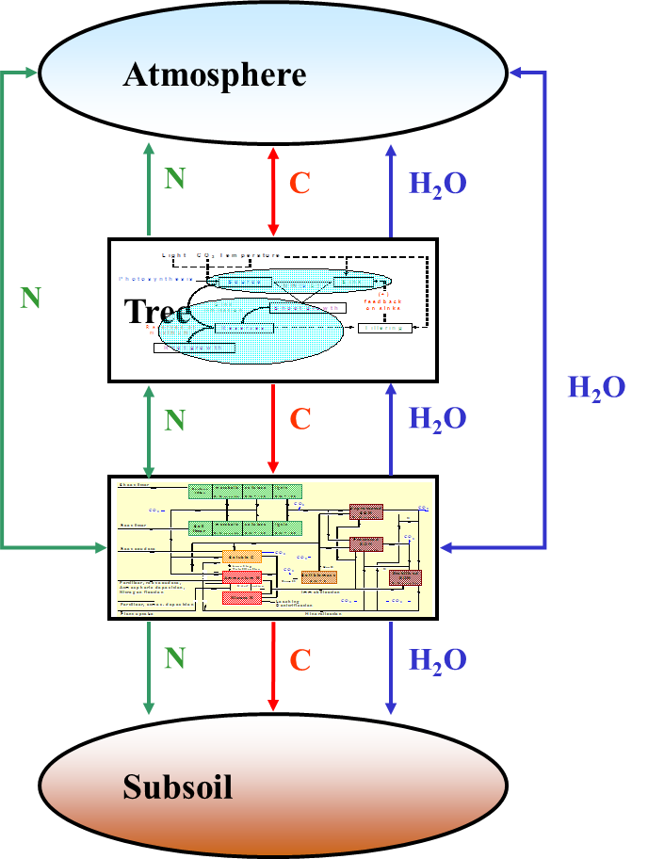
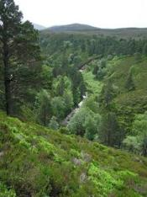
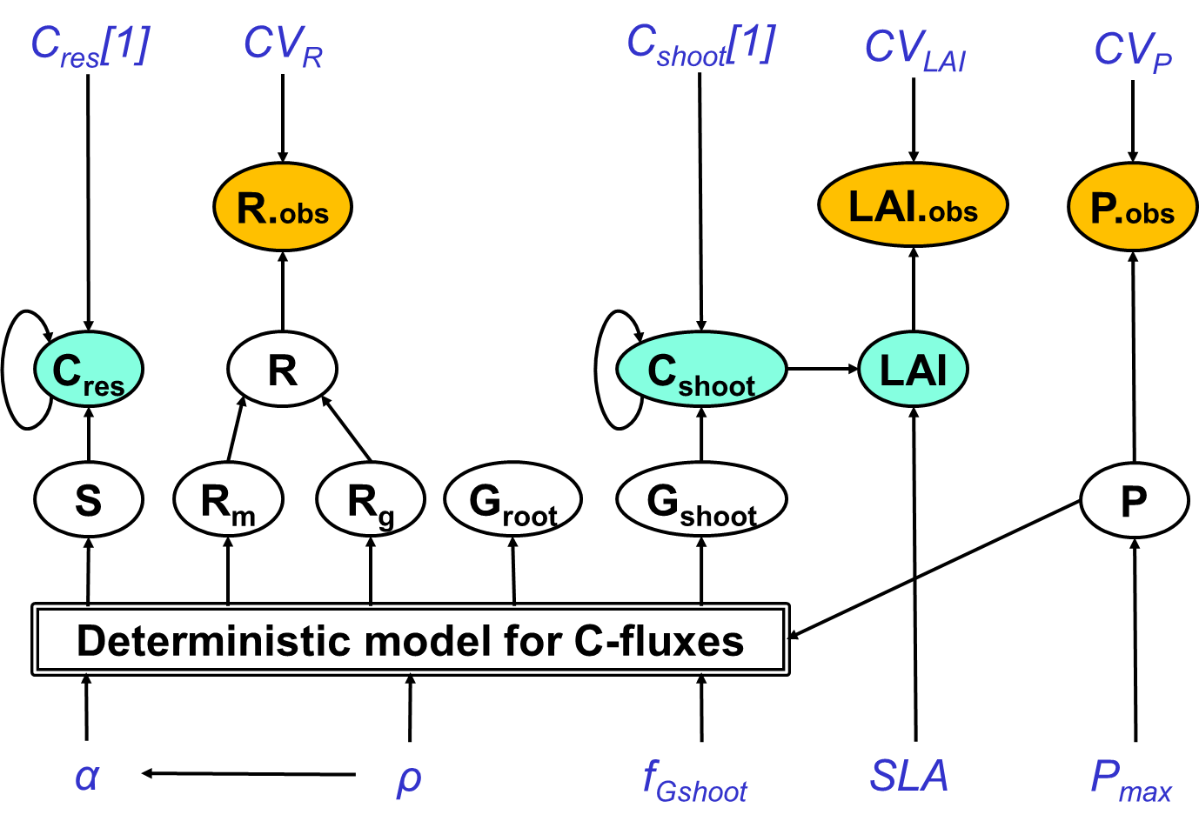
Bayesian Methods for Ecological and Environmental Modelling: DIAGNOSING MODEL WEAKNESSES
Marcel van Oijen
CEH-Edinburgh, 2019-09-12

Slide 2
Contents
Introduction
Comparison of prior and posterior
Analysing posterior model-data mismatch

Slide 3
1. Introduction

Slide 4
1.1 What can BC & BMC not do?
BC tells us about our parameters: what their values probably are
BMC tells us about the structure of our models: which model is more plausible than others.
But …
BC does not tell us why the most probable parameter values sometimes look strange
BMC does not tell us whether the most plausible model could be improved, or how.
However …
Comparing prior & posterior distributions can be informative, as can analysis of model-data mismatch

Slide 5
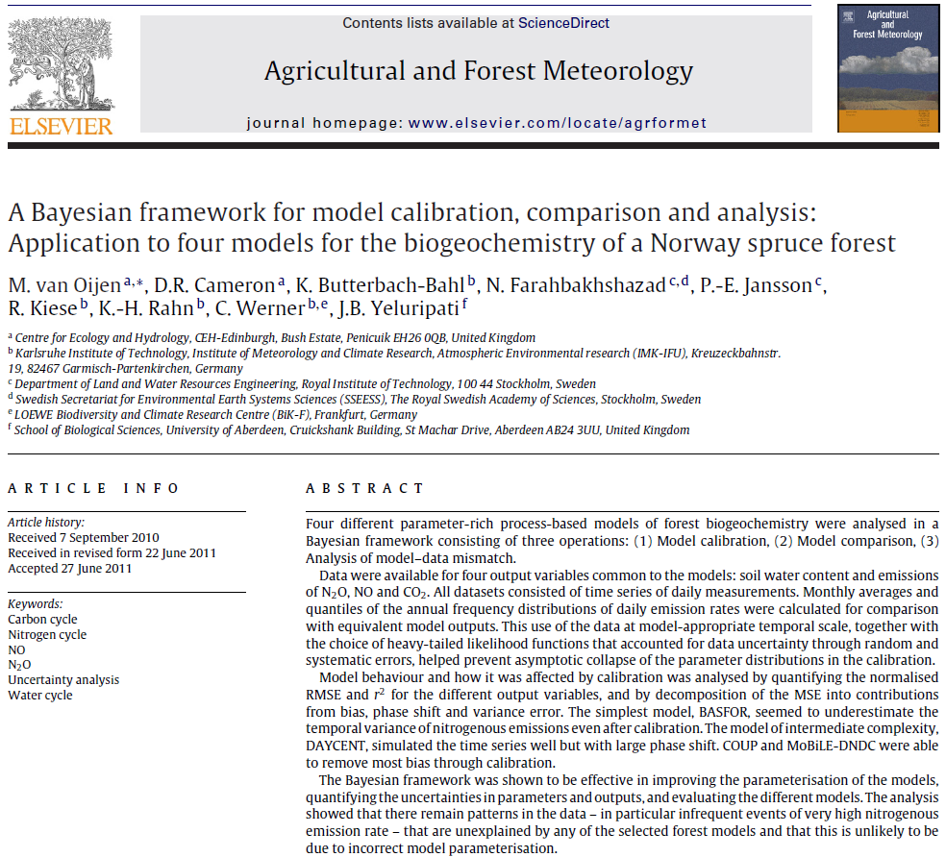
1.2 A three step-procedure

Slide 6
2. Comparison of prior and posterior

Slide 7
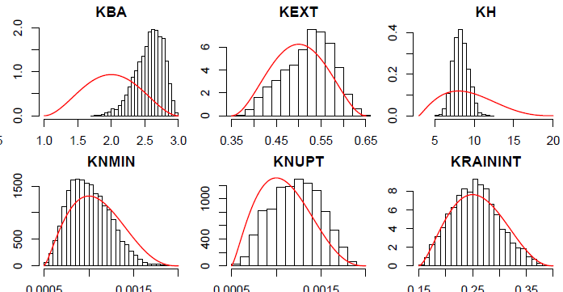
2.1 EXAMPLE: BC giving strange posterior pdf’s
Red lines: Prior pdf.
Black histograms: Posterior pdf after using data from Scots pine in Estonia.

Slide 8
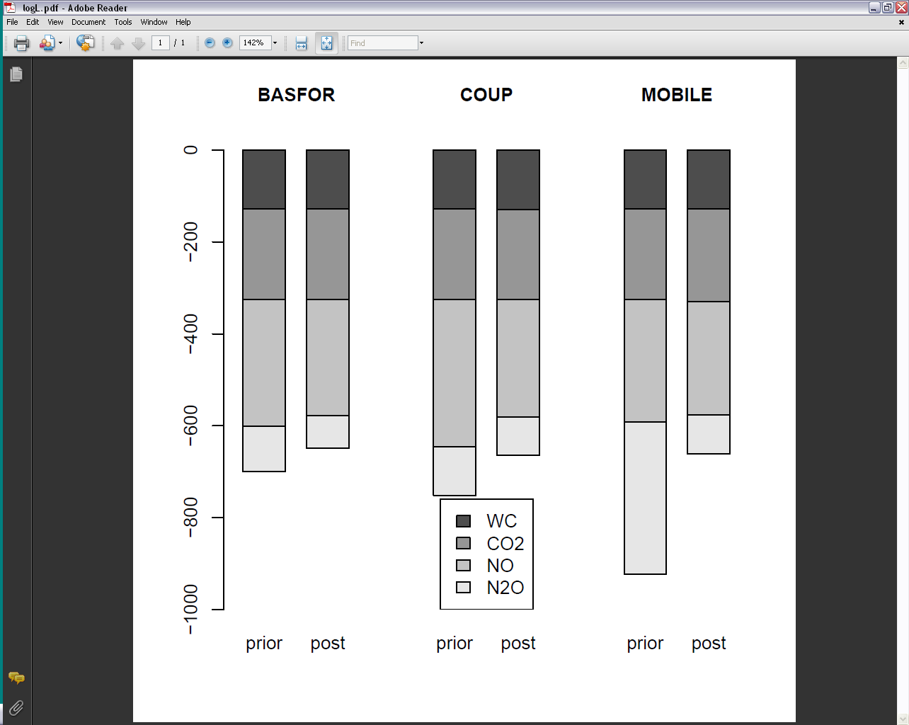
2.2 Analysis of model-data mismatch before/after BC: logL
[Van Oijen et al. 2011]

Slide 9
3. Analysing posterior model-data mismatch

Slide 10
3.1 Structural model error

Slide 11
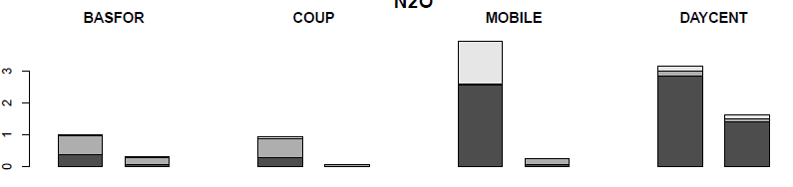
3.2 Analysis of model-data mismatch before/after BC: MSE
[Kobayashi & Salam, 2000, Agron. J. 92: 345-352]
MSE for N₂O
Prior
Posterior
Prior
Posterior
Prior
Posterior
Prior
Posterior
[Van Oijen et al. 2011]

Slide 12
3.3 Analysis of model-data mismatch before/after BC: MSE
TREE GROWTH
GPP (EDDY COVARIANCE)
1970-2010
1970-2010
1997
2008
2003

Slide 13
3.4 Can probability theory help in diagnosis?
Diagnosing model weaknesses
Decomposing mean-squared 'error' (MSE) between a modelled and measured time series (Kobayashi & Salam 2000, van Oijen et al. 2011)
MSE =
Difference
Mean
Variance
Phase
Linked state variable missing?
Error
Process missing?
Feedback missing?

